Slide 1
Mining the Dark Web: Drugs and Fake IDs
Andres Baravalle
Mauro Sanchez Lopez

Slide 2
Outline
Synopsis and introduction
Surface web, deep web and dark web
Dark markets
Going undercover in Agora
Results!
What now?

Slide 3
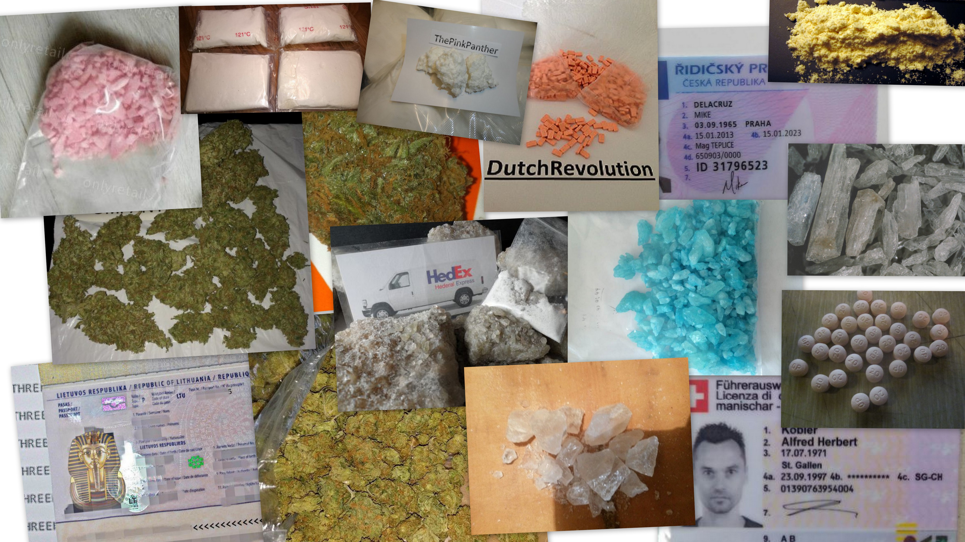

Slide 4
Synopsis
Within the last years, governmental bodies have been futilely trying to fight against dark web hosted marketplaces. Shortly after the closing of “The Silk Road” by the FBI and Europol in 2013, new successors have been established. Through the combination of cryptocurrencies and nonstandard communication protocols and tools, agents can anonymously trade in a marketplace for illegal items without leaving any record.
Research was carried out to gain insights on the products and services sold within one of the larger marketplaces for drugs, fake ids and weapons on the Internet, Agora, and on new developments after the demise of Agora.

Slide 5
Timeline
Timeline:
April 2015: Inception & funding request
June 2015 – September 2015: Data collection
September 2015 – April 2016: Data analysis
July – August 2016: Writing up
September 2016: Press release, and front page on the Time!
The team:
Dr Andres Baravalle, lead researcher
Dr Sin Wee Lee, researcher
Germans Zaharovs, research intern (data collection)
Mauro Sanchez Lopez, final year project (data analysis)

Slide 6
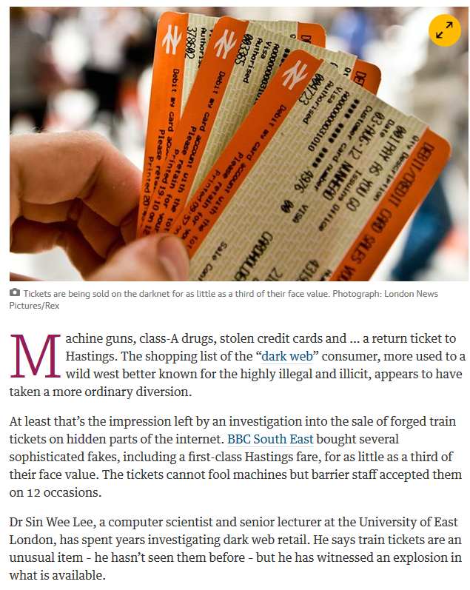
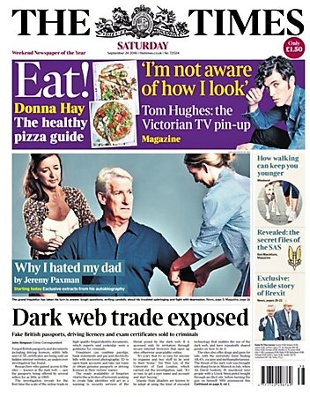
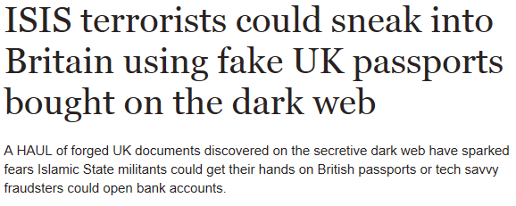
Media reception

Slide 7
Surface web, deep web and dark web
Research on the “size” of the Internet shows that its size (in term of hosts) has reached 1.05 billion hosts in early 2016 (http://ftp.isc.org/www/survey/reports/current/); about 3.5 billion users have now access to the Internet.
The surface web includes resources indexed by search engines and made publicly available.
Regardless of the effort done by these search engines in order to index more content, some of the contents available on the internet are yet not indexed. That’s what we call the deep web.
Bergman (2001) estimated the deep web to be 400 to 550 times larger than the content on the surface.
Under the deep web, we can find the dark web, the back alley of the Internet.

Slide 8
The dark web - a definition
We can define the Dark Web as "a collection of websites that are publicly visible, but hide the IP addresses of the servers that run them" (Egan, 2016).
These web sites can be visited by users, but it is hard to identify where they are hosted and who hosts them.
Hidden behind encryption protocols – typically either Tor (The Onion Routing) or I2P (Invisible Internet Project).
While the expression "dark web" as we intend it today is relatively recent, the concepts around dark web have been under investigation since the early 2000s.
The concept for example comes up in several works by Chen, H. et el. around a "Terrorist Knowledge Portal" (cited in Oman, 2004).

Slide 9
Dark web – crypto currencies and anonymized access
The Dark Web usually relies on the combination of crypto currencies such as bitcoins and anonymized access as the foundations in creating a market place for dealing illegal drugs, weapons and other illegal contrabands.
In recent years, the Dark Web has been in extreme scrutiny and investigations from legal authorities around the globe.
2015 estimates put the size of the dark web to 7,000-30,000 sites

Slide 10
Dark web markets timeline: Silk Road and Post Silk Road eras
February 2011 – February 2013: The Silk Road. Considered the first Dark Web hosted black market e-commerce platform. Any user could register anonymously to buy or sell goods with Bitcoins as currency driver. February 2013: FBI and Interpol operation against The Silk Road.
February 2013 – November 2014: Post Silk road era. Several market places, amongst which were Evolution, Hydra and The Silk Road 2.0. November 2014: Europol and FBI seize the vast majority of them during “Operation Onymous”.
The Silk Road and Post Silk Road eras are characterised by the fact that the police managed to shut down the markets.

Slide 11
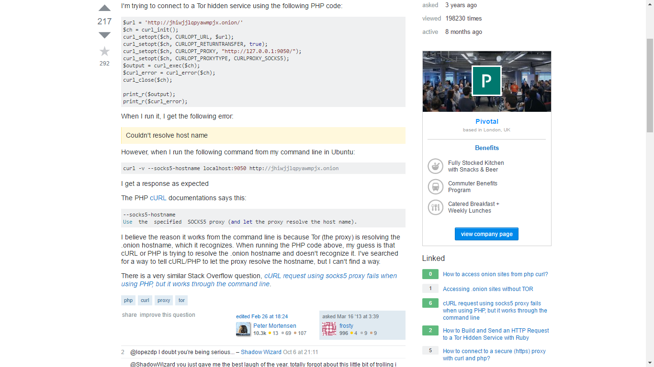
Frosty’s got a problem with his PHP code

Slide 12
The rise of Agora and the customer is always right
February 2014 – September 2015: The rise of Agora. One platform remained after operation Onymous: “Agora”. With no competition ahead, “Agora” became “king of the Dark Net”. Agora closed – possibly because of vulnerabilities in Tor (or not)
September 2015 - now: The customer is always right. 90+ markets. Alphabay supports reputation, multisig transactions, coin tumbling and Monero – and it’s nearly 20 times the size of Agora at its best.

Slide 13
What was Agora?
Agora was a portal selling both products and services, with a minimal set of rules.
At the time of our research the only items that couldn’t be sold were body parts, and the only service that was forbidden to sell was assassination.
In the final weeks (and before we completed our spidering), weapons were also forbidden
Agora changed host and domain name several times in an attempt to avoid cyber-crime law enforcers over its almost two years of existence.
One of the instances of this marketplace is the subject of our work (agorahooawayyfoe.onion).

Slide 14
Privacy and money
As for all black market operations, operations on Agora were not taxed, neither directly nor indirectly.
Agora offered sellers the possibility for sellers to place products that could not be typically sold legally.
The key aspects of Agora are largely similar to the ones of other illegal operations: privacy protection, exchange of money, illicit profits.

Slide 15
Mining data from Agora
Agora was invite-only - so access to the market place required first of all digging for an invite.
Then we had to have several sessions on the web site, to be able to inspect the interaction with the web site.
Finally, we were able to create human-like sessions with our software to proceed with the data collection.
The application used for collection has been built on a classic LAMP (Linux, Apache, MySQL, PHP) stack for data collection – and a variety of languages for data analysis.
TOR proxy running; thanks to Frosty (Silk Road) for some hints!
The miner was developed using command line PHP (and the cURL library) and an object oriented approach, using MySQL as a backend

Slide 16
Security protections – what Agora could have done
Protection of their business model in general, and specifically assets is something that Agora's team very much considered, but the techniques used by the team were neither advanced nor seemed to show awareness of the developments of the last few years.
There is extensive research on techniques to discourage web scraping; the most common ones include:
Turing tests
User-agent identification
Throttling of HTTPD requests
Obfuscation
Data tainting
Injecting markers
Network traffic analysis

Slide 17
And what Agora did
Turing tests (CAPTCHA) and user-agent identification were implemented at the time we started our work
Network traffic analysis was most likely introduced later
In time, the web site administrators might have realized that data mining was in progress as extra layers of protection were added: geolocation, session expiration and session management were added after we started the monitoring and before the closure.

Slide 18
What could they have done?
Much more…

Slide 19
Dilbert vs Agora
I
Around 2000 I developed a software to spider Dilbert’s web site (and then a few hundred others), to automatically download the daily comic strip. To some extent, the anti-spidering protection on Dilbert’s web site was more advanced.

Slide 20
Analysing the data
The analysis of the data has been carried with several tools - including Weka and ad-hoc Java and Python scripts
Libraries such as Pandas, Numpy, NLTK and MatPlotLib have been used for the analysis, integrated within a Jupyter notebook

Slide 21
What did we find?
Over 30,000 products on sale, mostly drugs and IDs, worth at least 170691.12 BitCoins (£26 million).
A staggering 1,233 sellers spread across 20 countries, with the largest number located in the USA and UK.
90% of the market was dominated by the largest 10% of sellers, with 80% of the market share going to the selling and purchase of drugs.
The highest number of drug sellers were from the USA (388), Australia (138) and the UK (137), while top countries by market size were Germany (£7.8 million), USA (£6.06 million) and Netherlands (£2.9 million).

Slide 22
80% of Agora was drugs
80% of the market was drugs
One seller, RADICALRX, was offering a cache of £10 million pounds worth of drugs, including Hydromorphone, Oxycodone, Fentanyl and Meth.
A US-based seller, HonestCocaine, boasted £1.24 million worth of cocaine for sale.

Slide 23
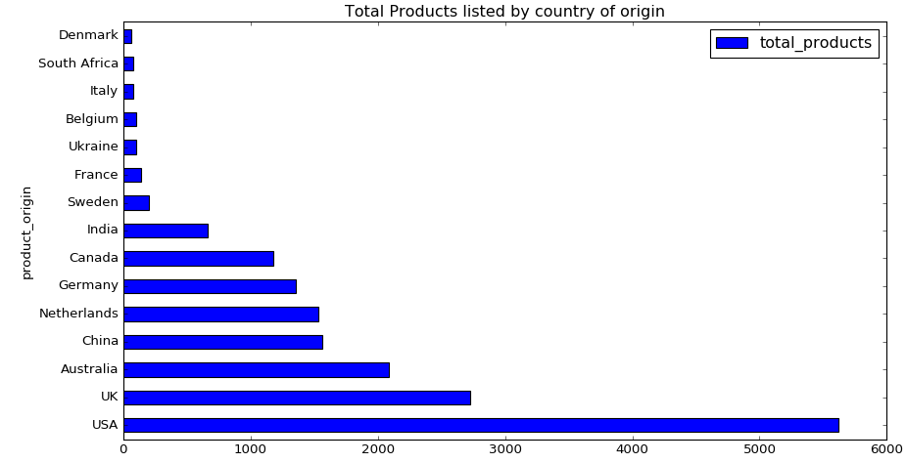
Geographical distribution
The drugs market is dominated by suppliers from US and UK, while sellers from China lives up to the stereotype and focus on watches and clothing (most likely counterfeit products).

Slide 24
Counterfeit documents
The total size of the market was ~ 3,700 bitcoins – about £650,000 at the time of our research (~ 2.6% of the market)
During our research, 84 scans and photos of passports were on sale, with 12 physical passports also being offered
A physical UK passport can be bought as cheaply as £752, while scanned passports can be purchased for as little as £7, and can be bought in bulk
Counterfeit identity cards can be bought for as cheap as £142 for an European id card and even cheaper for US state id cards, with prices ranging between £25 and £92

Slide 25
Counterfeit documents – driving licenses
US driving licenses ranged between £51-300; prices for European driving license were slightly more expensive, up to £419 but more impressively, in one of the listings, the vendor claimed that the license sold would be registered officially

Slide 26
Organised crime
We wanted to try to understand first of all how concentrated was the supply within the different vendors, and then if there were any existing patterns that would manifest that the supply was operated by well-coordinated organizations instead of individuals.
Over 90% of the market is dominated by the largest 10% vendors.
When looking at the hashish category, the mean amount on sale is 47g, with a median of 10g, but with some sellers selling up to 1 kg at the time. This is a reasonable indicator that organized crime is involved.
Finally, our research indicates that there was some use of sockpuppets – and we want to look at this more in depth
How do we know? Image analysis, for starters – but also NLP analysis (to complete)

Slide 27
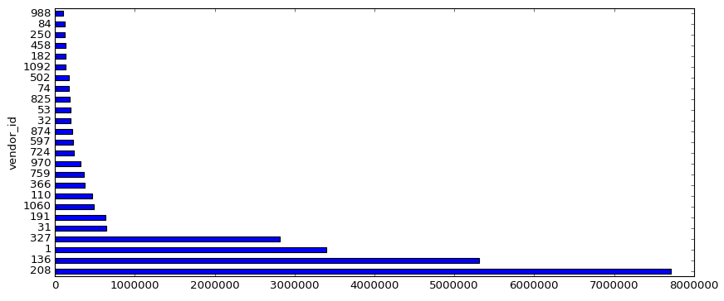
Organised crime – not teenagers in basements
Entities as RADICALRX have over 10 million dollars of product on sale on Agora over the time of our study.
This is hardly teenagers in basements – the scale is the one of organized crime.

Slide 28
How did it start?
About 18 months ago I went to a data science workshop organised by Outreach Digital, 3 Steps To Growth Hacking with Data (using import.io)
Amongst the stuff she presented, was some research by her colleagues at import.io, relating to the contribution of prostitution to UK’s economy. Andrew Fogg presented this work at Data Summit in San Francisco.
According to Andrew Fogg, the Office of National Statistics in UK estimates (£5.314bn, 0,4% of the GDP), are completely off the mark. His estimate is that contribution it is really closer to 0.6% of the GDP – the difference due to methodological errors in the government analysis and due to the fact that they didn’t count male prostitution.
That’s when I decided that I was going to look at drugs!

Slide 29
Conclusions
Over 170691.12 BitCoins (about £26 million) of merchandise where on sale on the period under examination. Over 30,000 products were on sale; 1233 sellers participated in the market, spread across 20 countries, with the largest number located in the US and UK.
Drugs, ids and also weapons were readily available in a trans-national marketplace, just one click away and anonymously.
When it comes to counterfeit documents, any EU ID card would allow the potential buyer to travel through any country in the EU, open bank accounts and in general create a new identity for himself/herself.
While we didn’t manage to collect any data on weapons as they were removed from the market early on
Black market services are working very cautiously, implementing security measures and hacker avoidance updates regularly. They are largely dominated by organized crime, and they keep resurfacing regardless of the efforts made to shut them down.

Slide 30
What’s next?
A more generalised architecture
The other 20%
Sharing the data
Legal highs: surface web and dark web
The role of organised crime
What’s new in the dark web?
Looking at other datasets

Slide 31
Any questions?
Dr Andres Baravalle
a.baravalle@uel.ac.uk
Mauro Sanchez Lopez
mauro.slopezs@gmail.com
Dr Sin Wee Lee
s.w.lee@uel.ac.uk

Slide 32
Bibliography
M. Splitters, F. Klaver, G. Koot and M. Van Staalduinen, "Authorship Analysis on Dark Marketplace Forums," in roceeding of Intelligence and Security Informatics Conference (EISIC), Manchester, 2015.
K. Bharat and A. Broder , "A technique for measuring the relative size and overlap of public Web search engines," Computer Networks and ISDN Systems, vol. 30, no. 1-7, pp. 379-388, 1998.
M. Bergman, "White Paper: The Deep Web: Surfacing Hidden Value," The Journal of Electronic, vol. 7, no. 1, 2001.
M. Eddy, "Inside the Dark Web," 04 02 2015. [Online]. Available: http://uk.pcmag.com/security/39461/guide/inside-the-dark-web. [Accessed 17 06 2016].
M. Egan, "What is the Dark Web? How to access the Dark Web. What's the difference between the Dark Web and the Deep Web?," 2016 06 28. [Online]. Available: http://www.pcadvisor.co.uk/how-to/internet/what-is-dark-web-how-access-dark-web-deep-joc-beautfiulpeople-3593569/. [Accessed 17 06 2016].
H. Oman, "Security Technology Progress: The 37th IEEE-AESS Carnahan Conference, Taiwan," IEEE Aerospace and Electronic Systems Magazine, vol. 19, no. 2, pp. 35-40, 2004.
H. Chen, "The Terrorism Knowledge Portal: Advanced Methodologies for Collecting and Analyzing Information from the ‘Dark Web’ and Terrorism Research Resources," 08 2003. [Online]. Available: http://www.slideshare.net/suyu22/the-terrorism-knowledge-portal-advanced-methodologies-for-collecting-and-analyzing-information-from-the-dark-web-and-terrorism-research-resources. [Accessed 17 06 2016].
A. Greenberg , "End Of The Silk Road: FBI Says It's Busted The Web's Biggest Anonymous Drug Black Market," 2 10 2013. [Online]. Available: http://www.forbes.com/sites/andygreenberg/2013/10/02/end-of-the-silk-road-fbi-busts-the-webs-biggest-anonymous-drug-black-market. [Accessed 16 6 2016].
A. Greenberg, "Global Web Crackdown Arrests 17, Seizes Hundreds Of Dark Net Domains," 11 07 2014. [Online]. Available: https://www.wired.com/2014/11/operation-onymous-dark-web-arrests/. [Accessed 16 6 2016].
A. Greenberg, "Drug Market ‘Agora’ Replaces the Silk Road as King of the Dark Net," 18 11 2015. [Online]. Available: http://www.wired.com/2014/09/agora-bigger-than-silk-road. [Accessed 17 06 2016].
E. L. Feige , "Reflections on the Meaning and Measurement of Unobserved Economies: What Do We Really Know About the 'Shadow Economy'," Journal of Tax Administration , vol. 2, no. 6, 2016.
R. S. Sandhu and P. Samarati, "Access control: principle and practice," IEEE Communications Magazine, vol. 32, no. 9, 1994.
A. Kolupaev and J. Ogijenko, "CAPTCHAs: Humans vs. Bots," IEEE Security & Privacy, vol. 6, no. 1, pp. 68-70, 2008.
V. Bhagwan and T. Grandison, "Deactivation of Unwelcomed Deep Web Extraction Services through Random," in Web Services, 2009. ICWS 2009. IEEE International Conference on, Los Angeles, CA, 2009.
C. Efroymson, "The Kinked Oligopoly Curve Reconsidered," The Quarterly Journal of Economics, vol. 69, no. 1, p. 119, 1995.

