Slide 1
Championing Open Source in Higher Education
Bruce Darby
Website and Communication
Information Services

Slide 3
Who am I?!
Bruce Darby
Product Owner
University of Edinburgh's Content Management System which is based on the Open Source CMS Drupal

Slide 4
Notes:
Community feel. Conferences have a real village feel.
Importance of recognizing the contribution from non-tech

Slide 5
Today’s topics
Open Source communities
How UoE supports this
Non-technical support for Open Source
Widening the focus
But closing some gaps
OpenUK
The future

Slide 6
Drupal Community Support
Content Management System is based on Drupal and we try to support this by
Contribution days (code sprints)
Sponsoring events
Venue space
Volunteering time to support events
Notes:
Community feel. Conferences have a real village feel.
Importance of recognizing the contribution from non-tech

Slide 7
Not technical!

Slide 8
However we do find it hard to contribute code

Slide 9
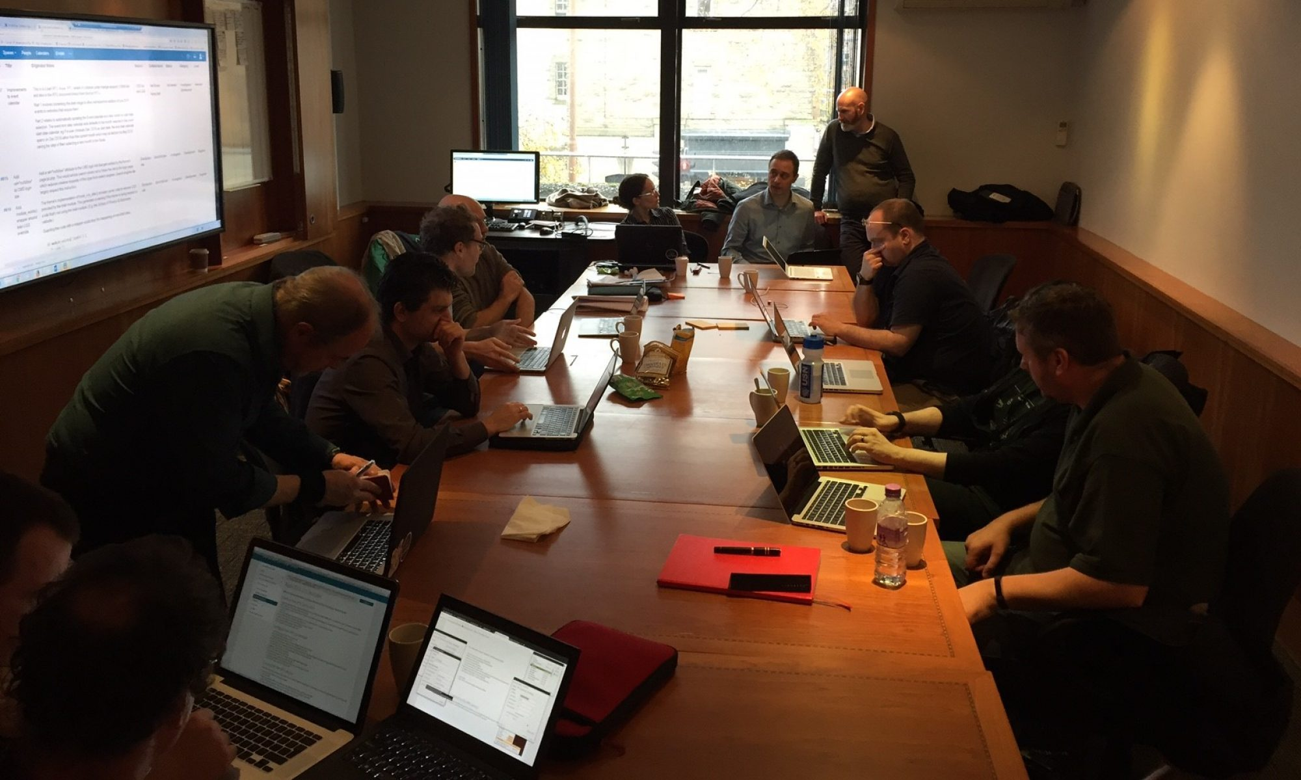
Notes:
Talk about the Drupal issue queue

Slide 10
Too focused on Drupal!

Slide 11
Open Source Champion
Wikipedia
Open Edinburgh event
Trying to build bridges between central services and academics

Slide 12
OpenUK
https://openuk.uk

Slide 13
OpenUK Awards
https://www.youtube.com/channel/UCD-o8S0VWsSDu2seacEwt_Q/videos

Slide 14
OpenUK Universities Committee

Slide 15
OpenUK
Event for UK University academics

Slide 16
Open Source in education
Red Hat – Educators
https://www.redhat.com/en/about/open-source-education/educators
POSSE (Professors' Open Source Software Experience)

Slide 17
Open Source in education
What do students know about open source?
very little about licencing
don’t understand how FOSS culture can lead to employment
Don’t understand the portability of open source skills
Notes:
Public portfolio of wok, coding conventions, communicating with other developers

Slide 18
Open Source in education
Not much overlap between
Higher Education,
Open Source
and Industry.
So even though Open Source is very big in industry it doesn’t feature highly on HE curriculum

Slide 19
Open Source in education
People in industry think that students understand all this perfectly!

Slide 20
Open Source in education
How do we prepare academics to teach open source
How to teach open source participation for students
Projects that students can work on
Employment
Build portfolios
Learn how to code in the real world
Notes:
Version control, documentation, comments, coding conventions, other people being able to understand, contribute to code.

Slide 21
Open Source at the University of Edinburgh
Open Educational Resources
https://open.ed.ac.uk/edinburghs-oers/
Wikimedian in residence
https://www.ed.ac.uk/information-services/help-consultancy/is-skills/wikimedia
Jupyter notebooks
https://www.ed.ac.uk/information-services/learning-technology/noteable/about

Slide 22
Questions

Slide 23
Further thoughts
How do we get more Universities involved?
What’s the best way for us to stay connected?

