Slide 1
E-Learning Mashups In the OpenSource Way
A presentation for BCS, Thursday 30th July

Slide 2
Hello and welcome
IT Manager for over 15 years, in both private industry and academic fields
Currently Head of Department of Digital Computing and Technology, GSM London
My personal focus is on removing fear as a barrier to computing – at both personal and organisational levels.
tara.mcbride@gsm.org.uk
Twitter: @gsmtara
Tara McBride, BSc AFHEA MBCS

Slide 3
Common challenges to development of E-Learning platforms
Variable government spending on education, e.g. 0.8 billion on primary compared to 24.2 billion on secondary in 2015
Variable in-house IT skills
Variable staff buy-in
Variable viewpoints – content delivery platform to interactive flipped classroom; from news bulletin to privacy nightmare
Lock in with existing IT purchase decisions
Curricular demands leaves little time to create online resources
http://www.ukpublicspending.co.uk/year_spending_2015UKbn_15bc1n_20#ukgs302

Slide 4
Common development requirements
Open communication in principle; yet controlled access for some, closed access for others.
Collaboration within a hierarchical education system.
A platform which is a success whether everyone uses it or not.
Notes:
Open yet controlled - Horizontal and vertical communication, yet privacy, cyberbullying and security needed to be central.
Collaboration in a hierarchical system – education tends to be hierarchical in structure, with information flows more often top-bottom, with sideways and bottom up communication much rarer.
A success whether everyone used it or not - we wanted staff to use the platform yet recognised they should be able to teach with or without the platform – it shouldn’t replace curriculum, rather support it

Slide 5
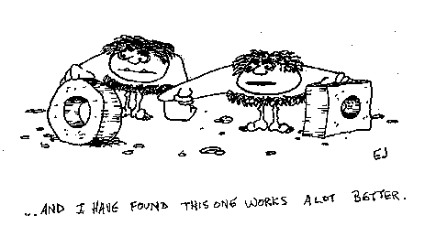
Common development requirements
Avoid lock-in with one provider, yet we want support
Spend little to nothing extra
Same features as other schools, but not to look same!
Reinvent the wheel (slightly!)

Slide 6
Combining “opensource way” with Web 2.0 technologies
Open exchange, participation and community
enable parents, staff and students as producer, consumer and curator
decentralise content creation
Sustainability of resources, rapid prototyping
move information flow to a write once, distribute many format
can be built on by non-technical staff
requires little or no additional infrastructure investment

Slide 7
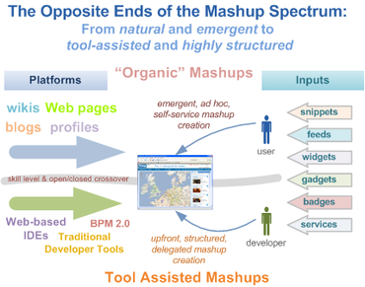
A browser side mashup
a single Web application that combines features and information from multiple Web sites
emphasis on interactive user participation and the Frankenstein-like manner in which they aggregate and stitch together first and third-party data
http://www.zdnet.com/article/mashups-the-next-major-new-software-development-model/

Slide 8
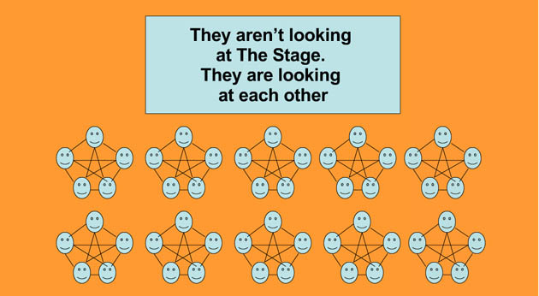
…using Web 2.0 technologies. Web 2.0 acts to decentralise content creation, connect peers and allows for reusable code
Notes:
Web 2.0 acted to shift power from powerful single point content creators to a more decentralised system, driven by a peer-connected audience. In an ideal educational environment, the same networking would be taking place, at the low costs inherent in “reusing” code and content.

Slide 9
Objective 1: enable all stakeholders as producer, consumer and curator
A possible solution:
Emphasis on a single platform for curation, with the curated tools being used for production and consumption.
In this way, one platform can be reconfigured as better tools arrived – no one tool is supreme, lock-in is avoided and rapid prototyping can be achieved.

Slide 10
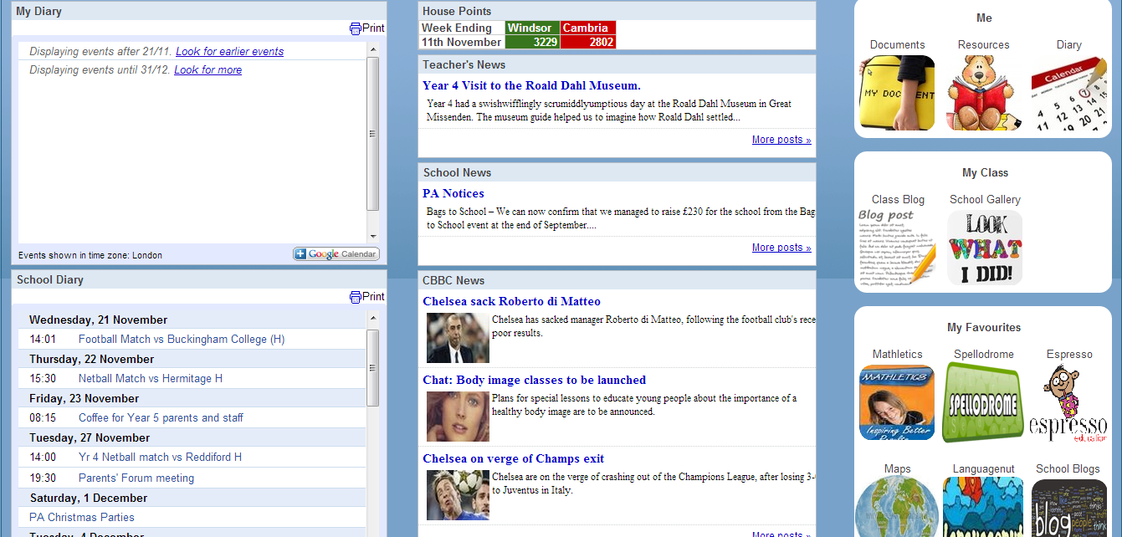
Curation: Curating tools and resources using Google Sites. Access controlled by group memberships
Embedded collaborative spreadsheets
Icons as links to external apps, Google apps, websites, Docs, Sheets etc – can theoretically link to ANY URL, including passing credentials within customised URLs
RSS feeding Google Calendar – content customised based on Google Apps login
RSS feeds from school blogs
RSS feeds from external news sites
Notes:
In this example, we used Google Sites to create a “launchpad” to tools for creation and consumption. The platform itself curates the best tools and content available at that time.
RSS feeds, URL linked icons and embedded documents allow for curation of content from other areas, rather than the platform itself as a store of content. When there are so many good sources of content on the web, why recreate it – curate it instead! RSS feeds keep the interface fresh without any need for an administrator to create content – students and staff always have a reason to return.

Slide 11
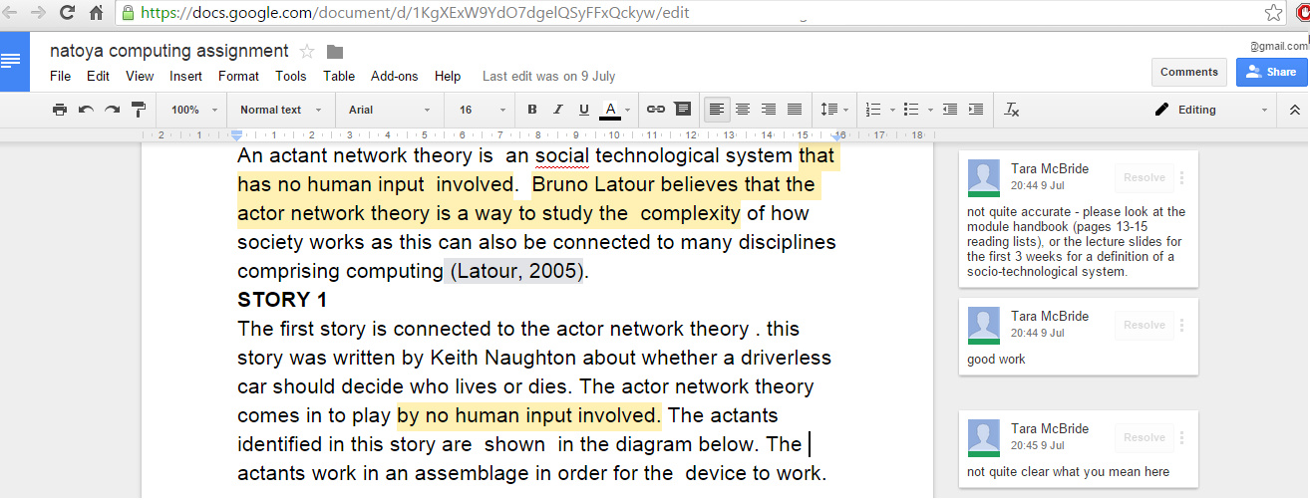
Enabling creation
Free collaborative document editing tools, such as Google Docs, allows for intervention DURING the student writing process.
Also allows inclusion of multimedia, e.g. text, video and picture of Romeo and Juliet!
Notes:
Ideal for flipped classroom, feedback outside or inside the classroom, and student-student collaboration, as well as teacher-student collaboration. In this example, I have used Google Docs, but increasingly, educational websites are building in collaboration, commenting and chat tools. Hyperlinks to these tools can be added to the curation point, e.g. Google Site.

Slide 12
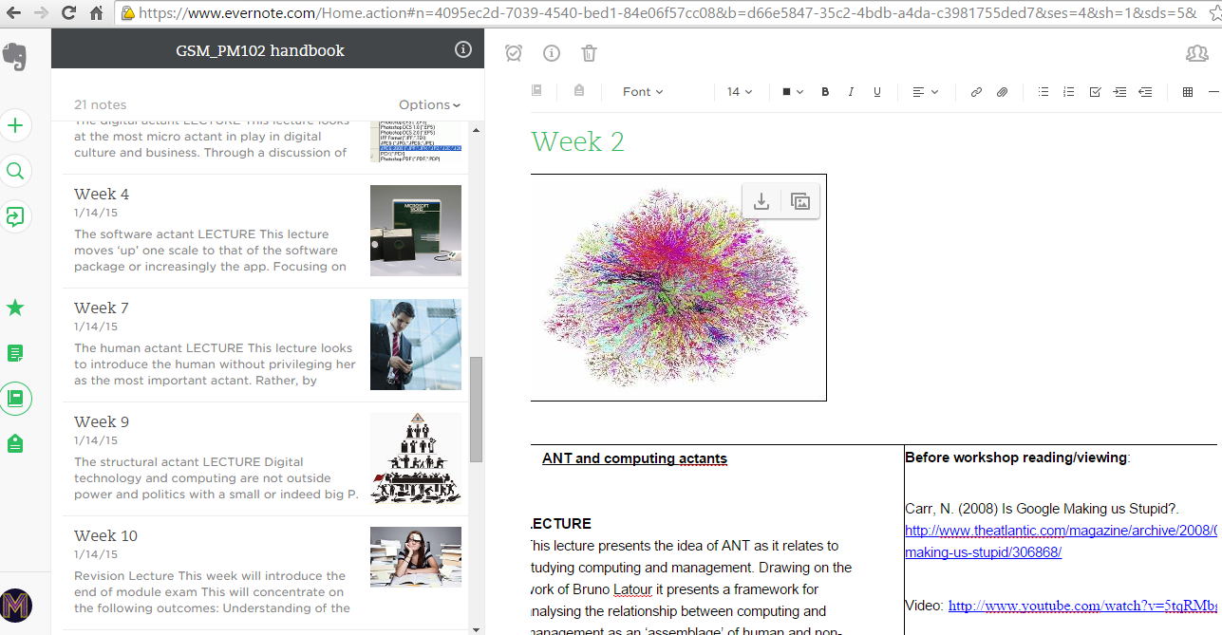
Enabling creation
Free notebook tools such as Evernote allow for collaborative syllabus writing.
Mixed media also allows for multiple learning styles.
Notes:
Ideal for moving away from static Word documents to distribute Schemes of Work and module handbooks, and more towards those using multimedia and blended learning resources. Students can quickly access, edit and hyperlink from notebooks, or even collaborate to create syllabus or dictionaries of concepts. Hyperlinks to these tools can be added to the curation point, e.g. Google Site.

Slide 13
Tools used to create Sites “mashup”
Google Apps for Education – Sites, Calendar, Groups
https://www.google.com/edu/products/productivity-tools/
Cost: Free
Weebly – external website and blogging
http://www.weebly.com
Cost: $0-$8 per month
External blogs and newsfeeds
http://news.bbc.co.uk/cbbcnews/hi/newsid_4900000/newsid_4907000/4907020.stm
http://www.rssmix.com/uk-news-feeds
Cost: Free
RSS feed management, to move information between all 3
http://feed2js.org/
Cost: Free

Slide 14
Objective 2 – decentralise content creation
One solution
“Mash in” tools that allow for content to be separated from structure, i.e. tools that support RSS.
Use blogs, RSS and automated email for automation.

Slide 15
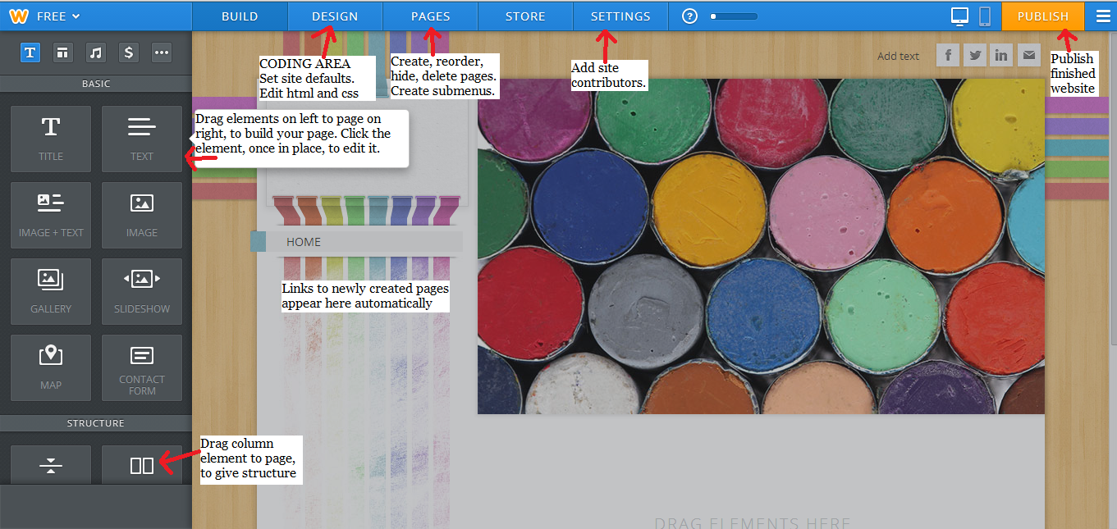
Objective 2: decentralise content creation
Drag and drop interfaces offered by content management platforms, e.g. Weebly, Wordpress offer a low cost alternative to outsourcing of website builds.
Little technical skills are required, and platform can be built up as public school website at low cost.
Notes:
This example shows the drag and drop interface offered by Weebly – website building tool is accessed directly in browser, no software install required.

Slide 16
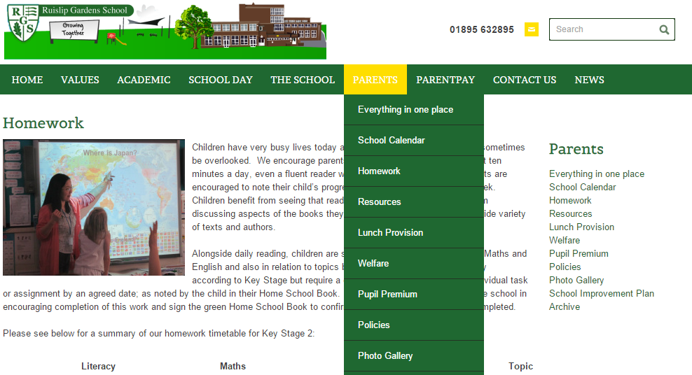
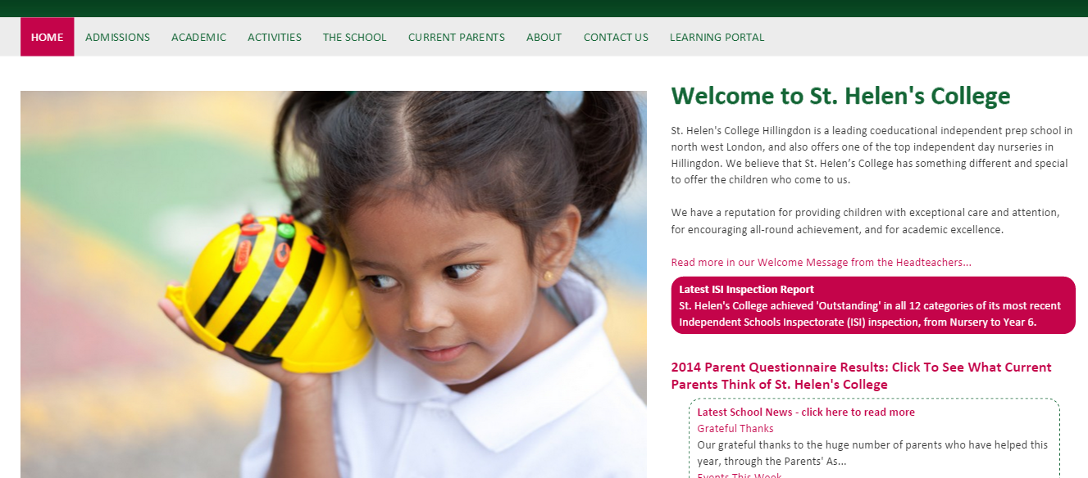
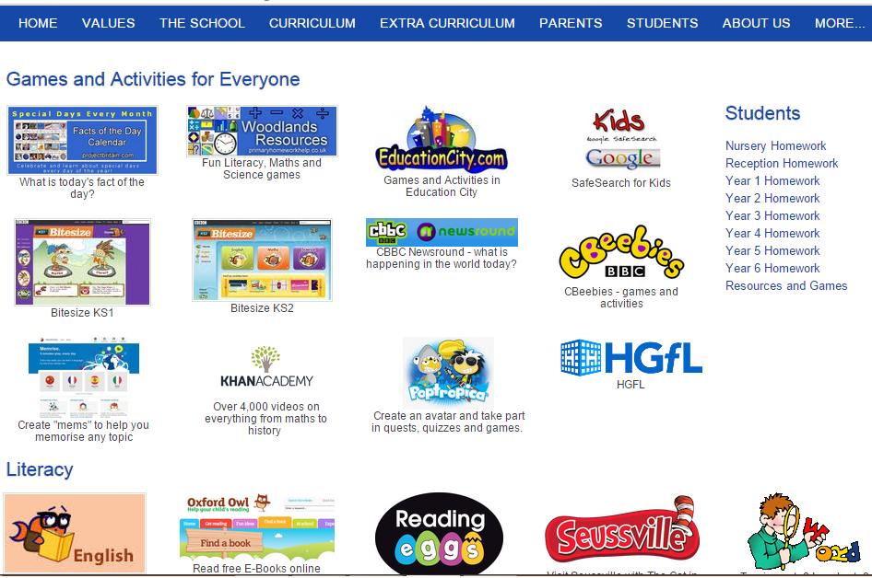
Blogs in disguise!!
Curate best apps/tools/websites at this time as resources for consumption.
E.g. these are hyperlinked images, built in drag and drop interface of Weebly – intended audience of parents, so placed on external website
Notes:
Again, why reinvent the wheel, or in this case content – in this example, a website is built in Weebly (despite being a blogging tool, standard webpage layouts can be created), with links to external apps and websites. Hyperlinks to these tools can also be added to the curation point, e.g. Google Site.

Slide 17
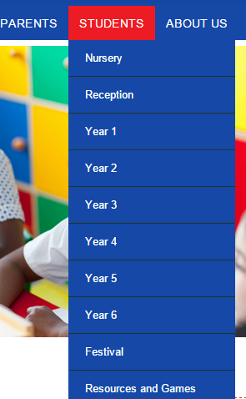
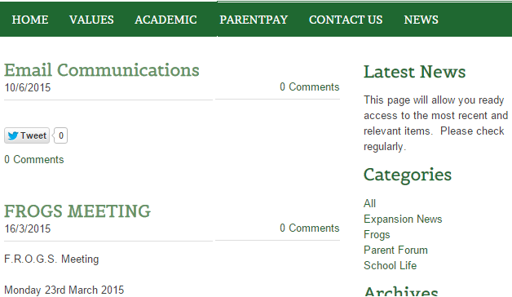
Objective 2: decentralise content creation
Website builders such as Weebly and Wordpress have inbuilt blogging tools
allows multiple users, and access levels per user
encourages controlled co-creation of content.

Slide 18
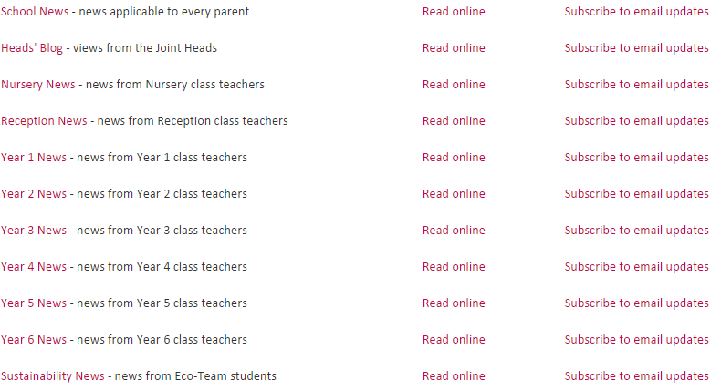
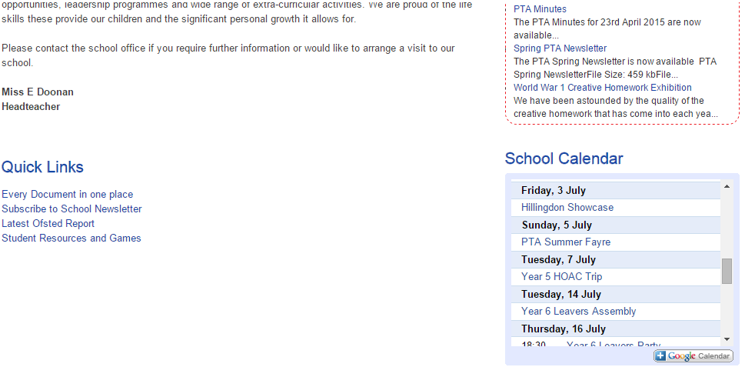
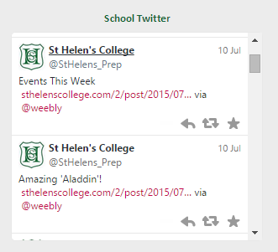
Objective 3: move information flow to a write once, distribute many format
Create blog post once – re-syndicated to school website, school E-Learning platform.
Can be added to any platform that accepts RSS.
“Mashed” with an email subscription service, blogs can then be resyndicated to parents and other stakeholders..write once, distribute many!
..Content can even be resyndicated to social media streams
..write once, distribute many!
Create event in central school calendar once – resyndicated to school website and E-Learning platform. Can be added to any platform that accepts RSS.

Slide 19
Tools used in website, blogging and newsletter “mashups”
External website and blogging tools
www.weebly.com
Cost: $0-$8 per month
Syndicated calendar feeds
https://support.google.com/calendar/answer/37083?hl=en
Cost: free
Resyndication of blogs to email and social media
http://feedburner.google.com/
Cost: free

Slide 20
Objective 3: Sustainability of resources
Challenge
Moving to a network based solution places a drain on the supply of hardware devices
Typical educational offerings are aging or underpowered, e.g. Intel Atom with Windows 7
One solution
Zorin OpenSource OS – lightweight install from USB/CD
Windows, Mac, Linux skins removes uncertainty of navigation for staff and students

Slide 21
Removing the fear barrier
Notes:
Zorin comes with a built-in “look changer”, which allows the installation to resemble most common Windows interface – an ideal gateway off Windows for nervous users, at zero cost for either the software or retraining users.

Slide 22
Tools used
Zorin OS – Educational version
http://zorin-os.com/
Cost: Free

Slide 23
Low-cost small school setup I have found works best (so far!)
External platform (public, parents): weebly.com
Internal platform (students, staff, parents): Google Apps for Education, with a curated Sites page as launching point
Connecting to external content, e.g. KhanAcademy
Internal and external platforms connected via RSS
Redundancy with 2 * business grade broadband lines, e.g. http://business.bt.com/broadband-and-internet/
Wireless connections will quickly outnumber wired, generally 3:1 – invest in centrally managed wireless, e.g. Ruckus, Netgear, Aruba, Aerohive

Slide 24
Frequently asked questions
Won’t we need IT Support?
“Mash in” sites with support and hosting built in, e.g. Google provides free phone and online support, while Weebly offers email support. Both also have vibrant online user communities.
Invest in Edugeek – a fantastic edutech resource!
If the tool is not critical, support is not so essential and it can be replaced if an alternative arrives – the aim of the mashup is not to say this tool is best always, but these tools are best now.

Slide 25
Frequently asked questions
What happens if the network goes down?
Worse case scenario, connect personal devices to mobile phone network, and work as usual.
How can we keep children safe?
“Mash in” tools that automatically use https
“Remix” Gmail content filters, e.g. content filters, block external email, auto-redirect questionable emails to year head
https://support.google.com/a/answer/1346936?hl=en
Explore the content filtering options already in your firewall. Alternatively invest in a content filter e.g. Smoothwall, Lightspeed

Slide 26
Frequently asked questions
I’m currently locked in with the council, e.g. Grid for Learning
Most GFLs will now port you to Apps but mostly as a branch of their own domain – this limits your ability to tweak how your domain is run. For support on moving away, see https://edudirectory.withgoogle.com/en
How can this link to educational value?
Blended learning, flipped classroom, collaborative document editing, curated Internet resources…
By creating a mashup of best tools at that time, rapid prototyping of best fit is always possible.

Slide 28
Building up – an educator’s perspective
Please welcome Mr. Mark Lewis, Director of Studies for St Helens’ College in Hillingdon.
Mark would like to discuss how he built on his “mashup”, from an educator’s point of view.

Slide 29
Thank you very much for your time
Please feel free to get in touch if you have any questions
tara.mcbride@gsm.org.uk
Twitter: @gsmtara
mlewis@sthelenscollege.com

